Slide 1
Action Team – Access to Care
Laramie county community partnership
5/19/2020

Slide 2
Outline for the Meeting
Who are we?
Introductions – via chat
Co-Chair Needed for Access to Care Team
Impacts of COVID-19 on Access to Care
Thoughts on our actions
Updates on subcommittees
Shared Measurement

Slide 3
Laramie County Community Partnership
“The mission of the Laramie County Community Partnership is to maximize resources and influence change to improve conditions of well being for people in Laramie County.”

Slide 4
Co-Chair?
Could be you.

Slide 5
Impacts of COVID-19 on Access
Decrease in people seeking needed care
Emergency Department
Immunizations
Accessibility of technology
Impact on chronic care management
Access to insurance coverage
Disparities

Slide 6
Receipt of Care – Emergency Care
Decrease in people seeking needed care
Emergency Department
50% reduction in overall patients
40% reductions in stroke and heart attack patients

Slide 7
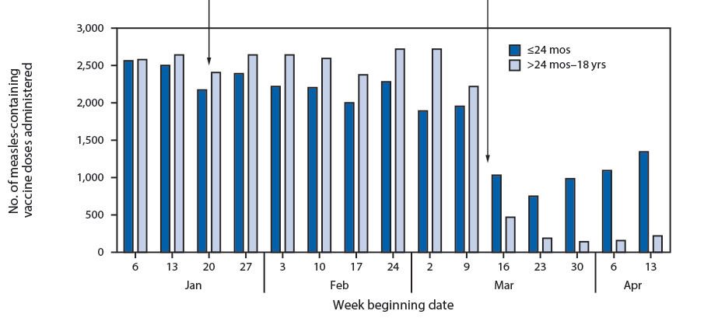
Receipt of Care – Childhood Immunizations
https://www.cdc.gov/mmwr/volumes/69/wr/mm6919e2.htm
https://www.cdc.gov/mmwr/volumes/69/wr/mm6919e2.htm#F1_down
Notes:
Potential to ask WY immunization program about similar drops

Slide 8
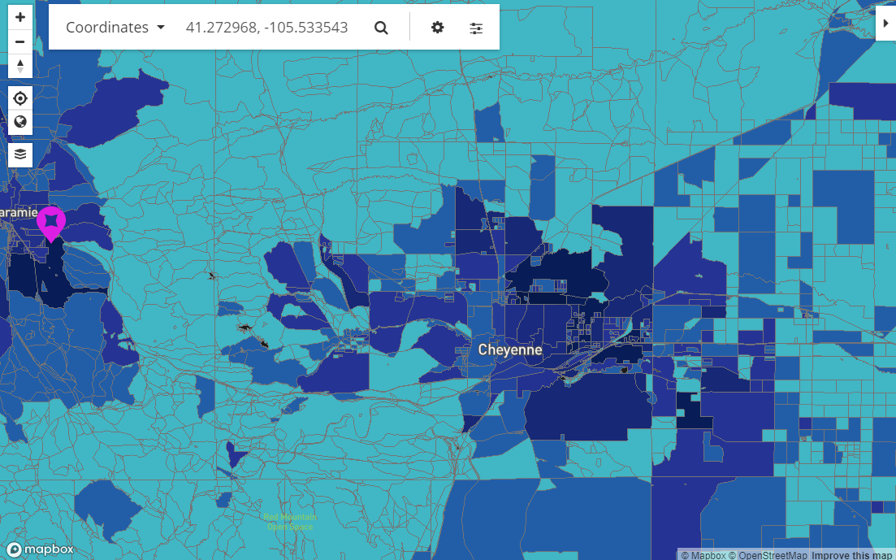
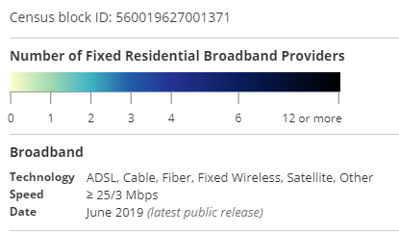
Telehealth – Access to Broadband
45% of WY residents in rural areas don’t have access to high-speed service
Digital literacy associated with education and access to devices
https://broadbandmap.fcc.gov/#/location-summary?version=jun2019&lat=41.272968&lon=-105.533543&tech=acfosw&speed=25_3&vlat=41.23166522612891&vlon=-104.91605980855388&vzoom=9.119783805503147
https://trib.com/news/state-and-regional/in-wyoming-access-to-high-speed-internet-depends-on-where-you-live/article_1fb35fbb-de1d-5a89-b70b-fe4a2c9322cb.html
https://cph.temple.edu/about/news-events/news/digital-literacy-gaps-could-limit-benefits-online-health-tools

Slide 9
Impact on Chronic Care
Many suggestions that this could be a residual effect.
Unable to find data to support at this point.

Slide 10
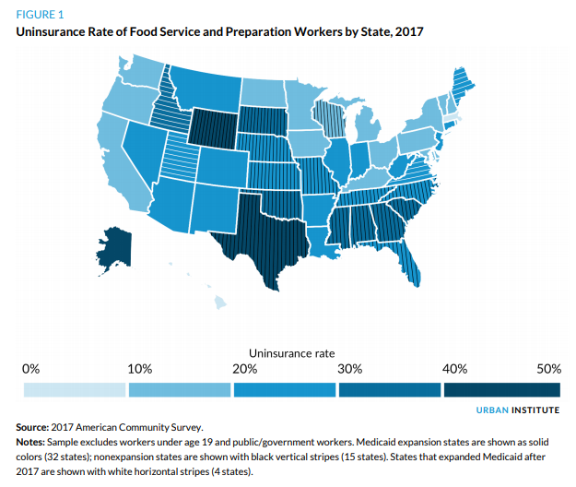
Insurance Coverage -
43.3% of Food Service and Preparation workers were uninsured in WY prior to the pandemic; highest in the nation
Not eligible for special enrollment periods
40% of US households earning less than $40,000 lost their jobs in March
Jobs and insurance are tied
30,000 people filed in WY since mid-March
909% increase over 2019
Expected increase in Medicaid and Marketplace enrollments
https://www.urban.org/sites/default/files/publication/101931/supporting_food_service_workers_during_covid-19_pandemic_0.pdf
https://thehill.com/policy/finance/497527-40-percent-households-earning-less-than-40k-lost-jobs
https://apnews.com/6e5a24cc47b94af197e696631356d651

Slide 11
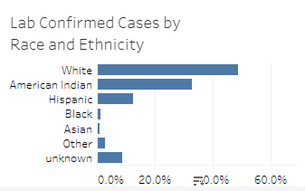
Racial and Ethnic Disparities
American Indian
Cases - 32.8%
Population - 2.7%
Hispanic
Cases - 12.5%
Population - 10.1%
White
Cases - 48.7%
Population - 83.8%
As of 5.18.20
https://health.wyo.gov/publichealth/infectious-disease-epidemiology-unit/disease/novel-coronavirus/covid-19-map-and-statistics/
https://www.census.gov/quickfacts/WY

Slide 12
Next Steps for the Action Team - Discussion
What is the highest priority?
Where are there strategies that are reasonable for us to address? What’s our capacity?
How can we be both addressing current problem, with lasting impact?
Notes:
Do we need more qualitative data?
Barriers to patients and organizations
How do those relate to pre-COVID needs
How can the partnership address these issues

Slide 13
Updates on Subcommittees
EPIC Care Link/Goal Connect
Remains on Hold
School Based Health Center
Drafting proposal
Assessing timing to ensure it considers with COVID response

Slide 14
Collective Impact
Common Agenda
Shared Measurement System
Mutually Reinforcing Activities
Continuous Communication
Backbone Support Organization

Slide 15
Comments/Questions?
Next Meeting June 16th @ 11:30am

