Slide 1

Action Team –
Housing
Laramie county community partnership
1/28/2019

Slide 2
Outline for the Meeting
Who are we?
  Introductions
Recap-Where are we now?
  Envision Center Grand Forks, ND
  Common Agenda
Discussion
Housing in the News

Slide 3
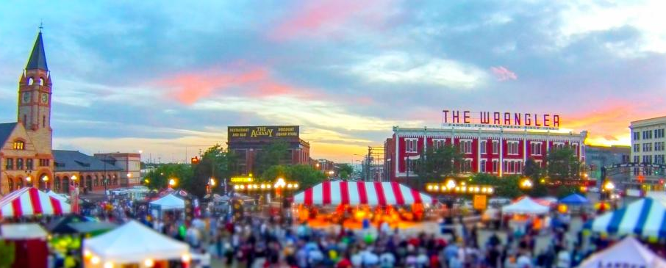
Introductions
Notes:
Please introduce yourself and your organization

Slide 4
Laramie County Community Partnership
“The mission of the Laramie County Community Partnership is to maximize resources and influence change to improve conditions of well being for people in Laramie County.”

Slide 5
Envision Center
Discussion with Grand Forks, ND
Follow-up thoughts?
  Lyle Konkol

Slide 6
Common Agenda Recap
We want a system where
  Partners and participants are aware of available resources
  Appropriate housing options exist across the housing spectrum
    Including for individuals on fixed incomes, families, children, individuals with mental health issues, and substance abuse disorders
  Opportunities exist for people to build skills and resources to achieve sustainable housing

Slide 7
Continuum of Care
A Continuum of Care (CoC) is a regional or local planning body that coordinates housing and services funding for homeless families and individuals. CoCs represent communities of all kinds, including major cities, suburbs and rural areas.
The Four Parts of a Continuum
Outreach, intake, and assessment in order to identify service and housing needs and provide a link to the appropriate level of both;
Emergency shelter to provide an immediate and safe alternative to sleeping on the streets, especially for homeless families with children;
Transitional housing with supportive services to allow for the development of skills that will be needed once permanently housed; and
Permanent and permanent supportive housing to provide individuals and families with an affordable place to live with services if needed.
https://endhomelessness.org/resource/what-is-a-continuum-of-care/
Notes:
In 1995, the US Department of Housing and Urban Development (HUD) began to require communities to submit a single application for McKinney-Vento Homeless Assistance Grants in order to streamline the funding application process, encourage coordination of housing and service providers on a local level, and promote the development of Continuums of Care (CoCs). By requiring communities to submit a single application, HUD hoped to encourage a more structural and strategic approach to both housing and providing services to homeless people. A CoC would provide this more strategic system by providing homeless people with housing and services appropriate to their range of needs.

Slide 8
Wyoming CoC
Conduct the Point in Time Survey (1/23/20)
Submit Emergency Solutions Grant
  Yes House; VOA, Council of Community Services, Sweetwater Resource Center, COMEA, Interfaith Good Samaritan, Community Action – Natrona County
Coordinate the use of HMIS
  Data Collection and analysis
Develop ten-year action plan
  Utilize the results of Dr. Marbut’s report to drive change
Proposal: Can we serve as the regional meeting place for the CoC?

Slide 9
Housing in the News
Homeless Assistance Act of 2019
  https://www.congress.gov/bill/116th-congress/house-bill/4302/text
Joint Interim Corporations, Elections, and Political Subdivisions Committee
  Considering bill prohibiting towns and counties from requiring developers to build or pay for housing
  Next meeting Cheyenne, November 18-19th

