Slide 1
Action Team – Housing
Laramie county community partnership
4/28/2019

Slide 2
Outline for the Meeting
Who are we?
Introductions – In Chat Box
LCCP Mission
Update on COVID and housing
Letter to Auditor
Data gathering
Current legislation
Our action – Brenda Birkle
Available funding and CoC Update – Robin Bocanegra
Update on family shelter and campus – Lori Kempter
For the Good of the Order
Notes:
Ask for someone to take notes

Slide 3
Laramie County Community Partnership
“The mission of the Laramie County Community Partnership is to maximize resources and influence change to improve conditions of well being for people in Laramie County.”

Slide 4
Housing Action Team – Common Agenda
We want a system where
Partners and participants are aware of available resources
Appropriate housing options exist across the housing spectrum
Including for individuals on fixed incomes, families, children, individuals with mental health issues, and substance abuse disorders
Opportunities exist for people to build skills and resources to achieve sustainable housing

Slide 5
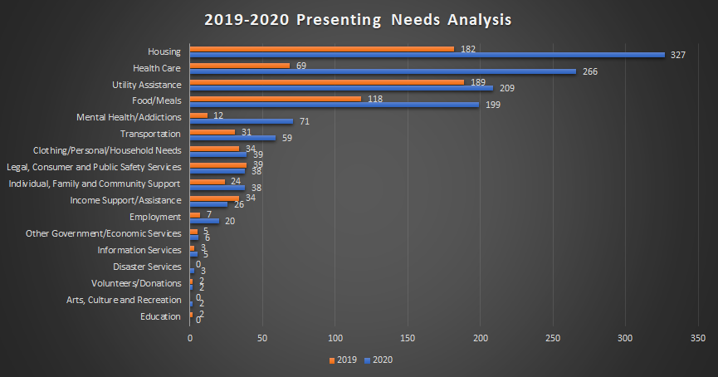
Housing and COVID-19
Letter to Auditor Racines
Data Gathering Efforts
Organizations asking about eviction to clients and landlords
Wyoming 2-1-1
Do you have data?

Slide 6
Our role
If no statewide ban on evictions and foreclosures, what is our role?
Campaign to inform landlords/renters of options/resources

Slide 7
Proposed Legislation
Temporary program through WCDA
Funding for landlords affected by unpaid rent
Lost 25% of more of rental income generated by property due to COVID
From March 13th and show loss within 45 days
Renters must
Be at or below 200% of FPL
Experienced lost hour income, terminated, or have reduced hours due to COVID
Landlords must
Not evict due to ability to pay
Not charge rent when receiving payment from this fund

Slide 8
Questions and next steps
What if landlord doesn’t choose to apply for funds? Is there protection for renters?
What is considered COVID related?
Is total funding sufficient?
Timing – 45 days after declaration of public health emergency, what of those that experience loss further out?
What do we want our next steps to be?

Slide 9
Housing Funding
Category B of FEMA’s Public Assistance Program
Non-Congregate Sheltering
Community Services Block Grant
Received an additional $5 million through CARES Act
Expected to be contracted an distributed by early June
Emergency Solution Grant
Additional $1.1 million for WY in early June
Community Development Block Grant
How can this group help?

Slide 10
Updates on Family Shelter and Resource Center
General updates
Funding
Location
Workgroup
Next steps
How you can be involved?

Slide 11
For the good of the order

