Slide 1
Action Team – Housing
Laramie county community partnership
7/28/2020

Slide 2
Outline for the Meeting
Who are we?
Introductions – In Chat Box
LCCP Mission
Update on COVID and housing
Learning Opportunities
For the Good of the Order
Notes:
Ask for someone to take notes

Slide 3
Laramie County Community Partnership
“The mission of the Laramie County Community Partnership is to maximize resources and influence change to improve conditions of well being for people in Laramie County.”

Slide 4
Housing Action Team – Common Agenda
We want a system where
Partners and participants are aware of available resources
Appropriate housing options exist across the housing spectrum
Including for individuals on fixed incomes, families, children, individuals with mental health issues, and substance abuse disorders
Opportunities exist for people to build skills and resources to achieve sustainable housing
Notes:
Ask for note taker

Slide 5
Coordinated Entry/Data Collection
Ensure that individuals receive the right services in the community
Currently use the HMIS system
Requirement for those receiving HUD funding (who in our community is using?)
Can be used by other community partners ($250 annual fee)
Shared measurement
Vision of both coordinating care and preventing homelessness
Requested data from the system to look at impacts of COVID
Update on EPIC CareLink tool

Slide 6
Housing Updates
CDBG public hearing on funding
CSBG Funding Update
Federal Eviction Moratorium ended 7/24
1/3 of renters were in rentals with federally backed mortgages
Wyoming Community Develop Authority COVID relief
State Lands and Investment Board – COVID relief

Slide 7
Housing Updates - Continued
End of enhanced unemployment – 7.6% in June (peak in April at 9.6%)

Slide 8
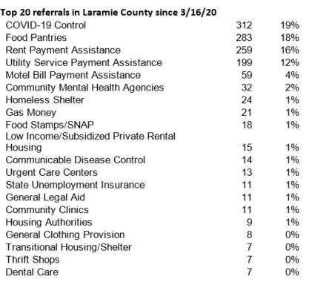
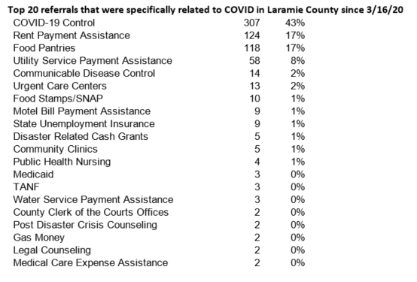
211 Data – through June

Slide 9
Opportunities for Learning
Community Information Exchange Summit
Using Care Act Funds to Strategically Respond to Public Health and Economic Crises Among People Experiencing Homelessness – Wednesday, July 29th
Preparing for the Coming Eviction Crisis – Tuesday, August 11
Housing Stability and Coronavirus Response and Recovery – July 29th
Homelessness and COVID-19: A Merger of two Epidemics – Recording
Infographic on Homelessness and Health
Online Summit: Innovations in naturally Affordable Housing – August 11-12

Slide 10
Thanks Lori
Lori moving on to her next big role.
Need a co-lead for the housing action team. Please let me know if you are interested.

Slide 11
For the good of the order

